Slide 1
Graduate Artificial Intelligence CS 640 Measures of Success
Jeffrey Considine
jconsidi@bu.edu

Slide 2
Plan for Today
Course Logistics
Regression and loss functions
Binary measures of success
Making decisions
Utility theory
Back to loss functions
AI Research at BU (if time)

Slide 3
Blackboard
https://learn.bu.edu
Links to everything for this class will be here.
Resources / extra readings are here.
They may come up in homework or exams.

Slide 4
Course Logistics
Lectures: Tuesday/Thursday
Discussions: Fridays
Hands on practice with topics from lecture.
Graded exercises each week.
Homework:
Assigned/due every week except around midterm.
Usually posted Tuesday, due next week Thursday.
2 days for late submission (-1% per hour)

Slide 5
Grading
Discussions: 12%
Homework: 48%
Midterm: 20%
Final: 20%

Slide 6
Please, no AI Slop or Verbosity!
Most assignments will be focused on implementing techniques covered in class, but you will sometimes be asked questions with text answers. For example, you may be asked to explain, motivate or otherwise argue for an approach. In those cases, you are expected to give a concise and direct answer and not be unnecessarily verbose. Points may be deducted for poorly written responses.
^^ in the formal syllabus.

Slide 7
You may use generative AI but use it well!
Don’t waste the grader’s time.
Don’t lose points for
Saying it is such an interesting question…
Answering a couple other questions!
Answering the next question too.
Making your answer pretty with redundant headings or emojis.
Repeating something an LLM hallucinated.
Be concise and to the point.
Submit something better than ChatGPT!
Don’t forget to cite! A chat link suffices.

Slide 8
Course Staff
Instructor Jeffrey Considine (me)
Email: jconsidi@bu.edu
Office: CDS 1645
Office Hours:
Monday 11-12
Tuesday 3-4
Wednesday 1-2
Thursday 1-2
Teaching Fellow Mahir Patel
Email: mahirp@bu.edu
Office Hours Location: TBD
Office Hours:
Monday 12-1:30
Wednesday 2-3:30
(subject to getting a room)

Slide 9
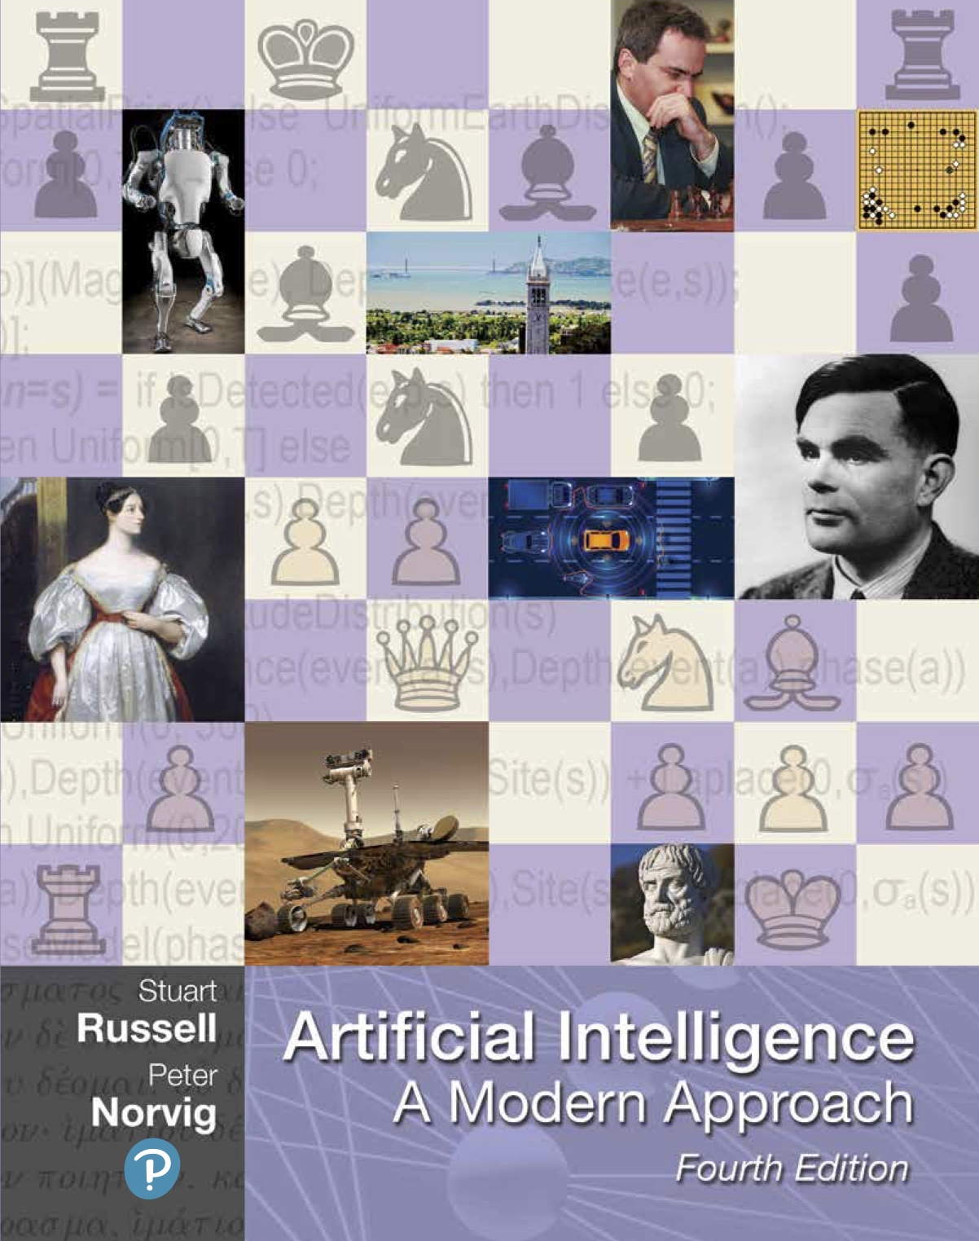
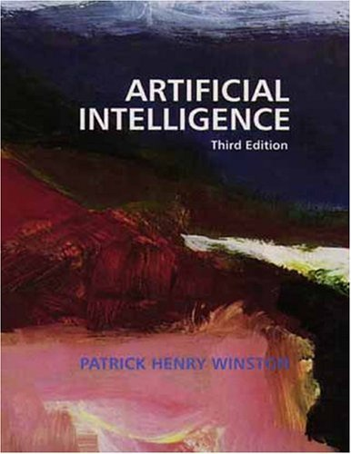
Textbooks – None Required But These Two are Good
Will post links to some of these chapters.
Winston made them publicly available.

Slide 10
Any Questions?

Slide 11
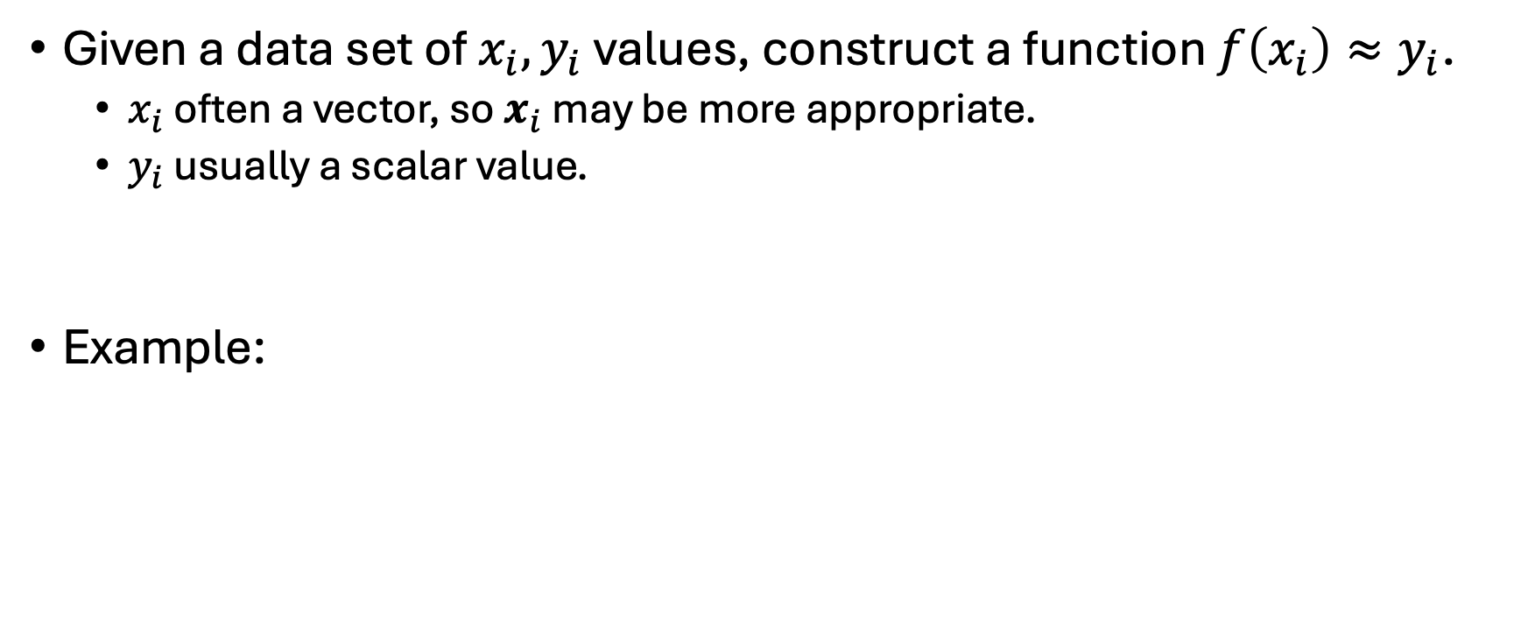
Regression
Given a data set of $x_{i}, y_{i}$ values, construct a function $f\left(x_{i}\right)≈y_{i}$.
$x_{i}$ often a vector, so $x_{i}$ may be more appropriate.
$y_{i}$ usually a scalar value.
Example:

Slide 12
How Do We Grade Regressed Functions?
???

Slide 13
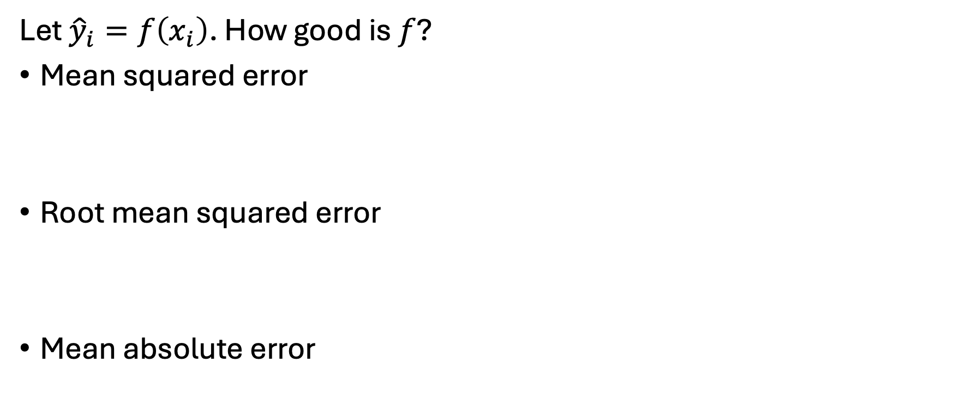
Loss Functions
Let ${\hat{y}}_{i}=f\left(x_{i}\right)$. How good is $f$?
Mean squared error
Root mean squared error
Mean absolute error

Slide 14
Sanity Check
Is this a machine learning course or an artificial intelligence course?

Slide 15
Regression versus deciding?
???

Slide 16
Any Questions?

Slide 17
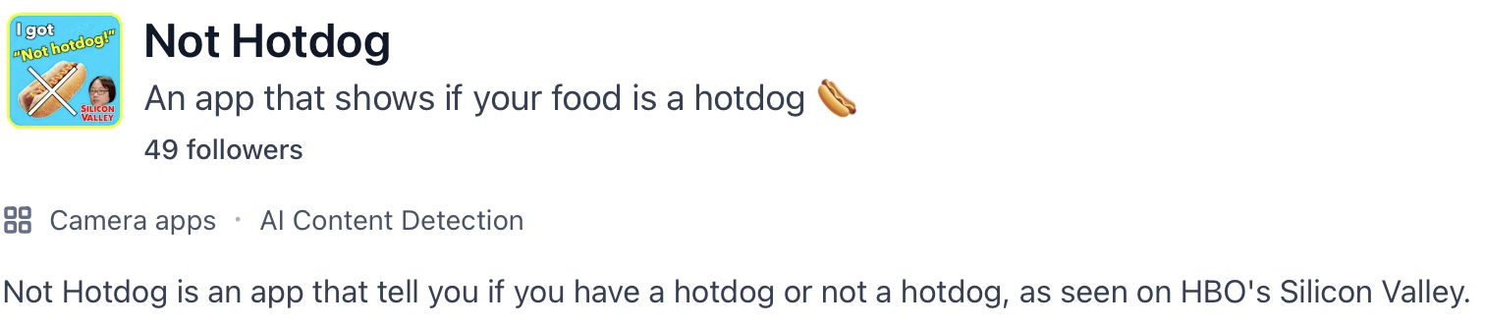
Binary Measures of Success
Image source: https://www.producthunt.com/products/not-hotdog

Slide 18
Accuracy
Accuracy = # correct predictions / # predictions
Not all errors are equal.
Some mistakes are more expensive than others.
Examples?
Degenerate example?
Notes:
Degenerate example = always predict false when positives are rare

Slide 19
Confusion Matrix (counts)
* “Truth” may be “best available standard”.
 | Prediction: positive | Answer: negative
Truth: positive | true positive | false negative
Truth: negative | false positive | true negative
Notes:
False positive = Type I error
False negative = Type II error

Slide 20
Rates
True positive rate: P(said hotdog | was hotdog)
Also called “sensitivity” and “recall”.
True negative rate: P(said not hotdog | was not hotdog)
Also called “selectivity”.
False positive rate: P(said hotdog | was not hot dog)
False negative rate: P(said not hotdog | was hot dog)
Precision = P(was hotdog | said hotdog)

Slide 21
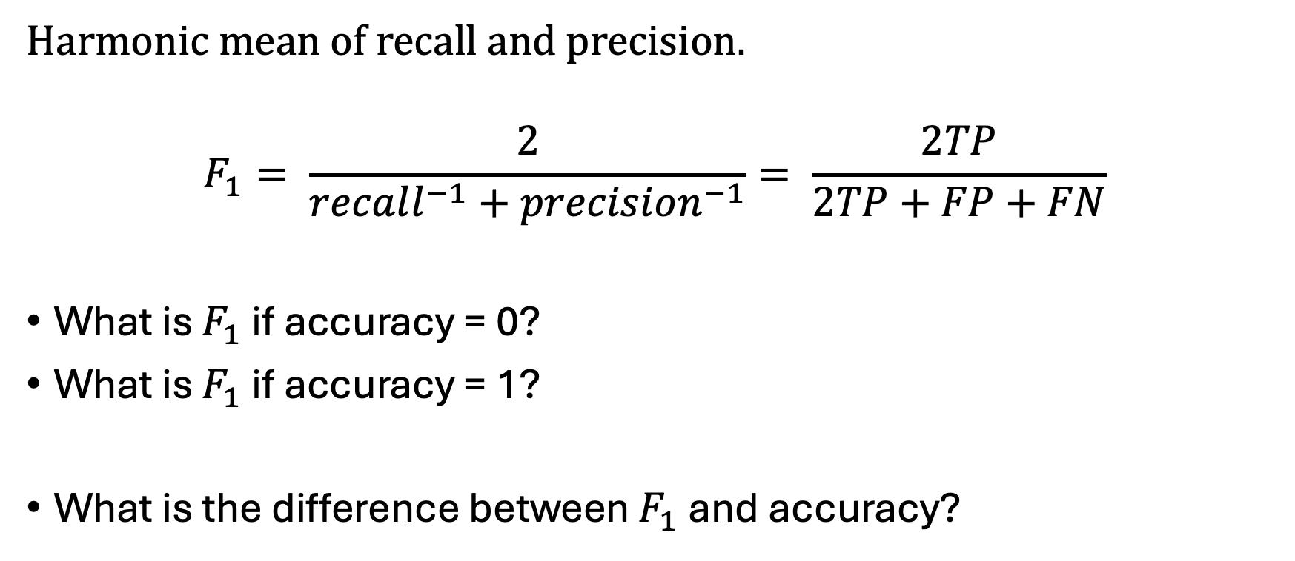
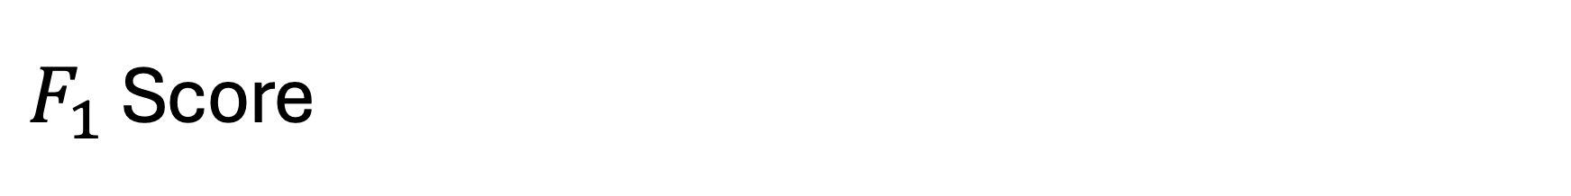
$F_{1}$ Score
Harmonic mean of recall and precision.
$$F_{1}= \frac{2}{recall^{−1}+precision^{−1}}= \frac{2TP}{2TP+FP+FN}$$
What is $F_{1}$ if accuracy = 0?
What is $F_{1}$ if accuracy = 1?
What is the difference between $F_{1}$ and accuracy?

Slide 22
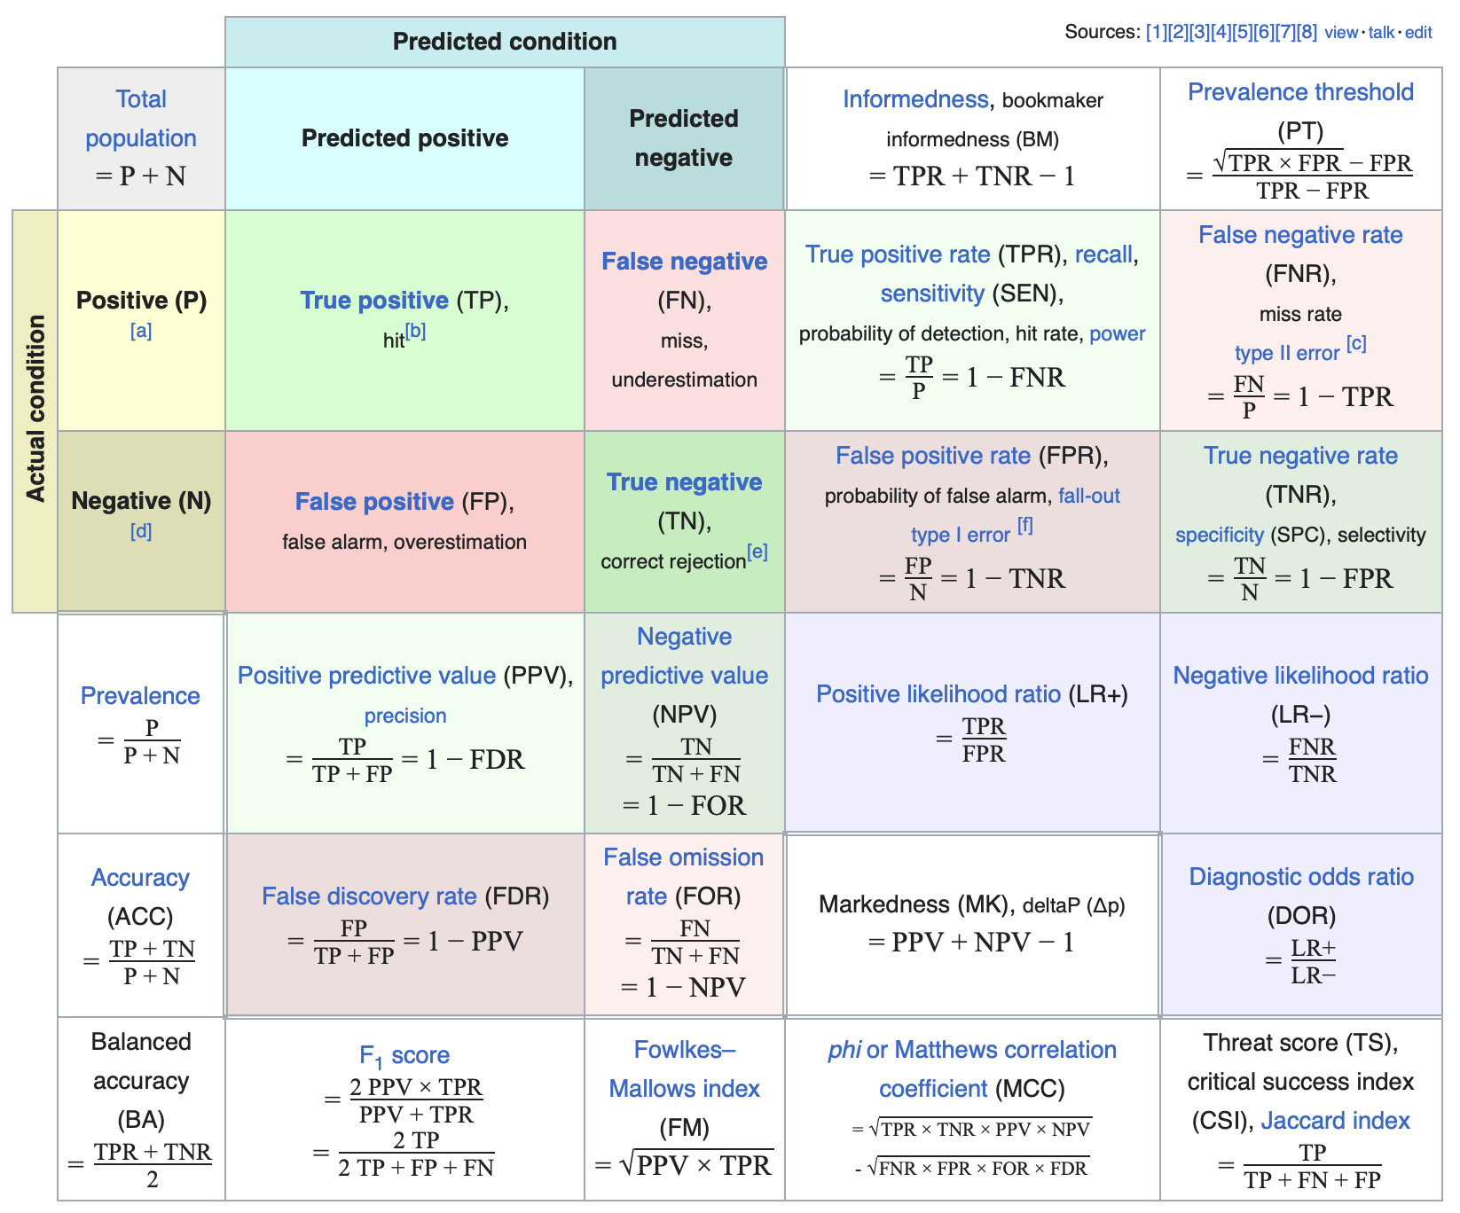
Many Variations of these measures
Image source: https://en.wikipedia.org/wiki/Evaluation_of_binary_classifiers

Slide 23
Any Questions?

Slide 24
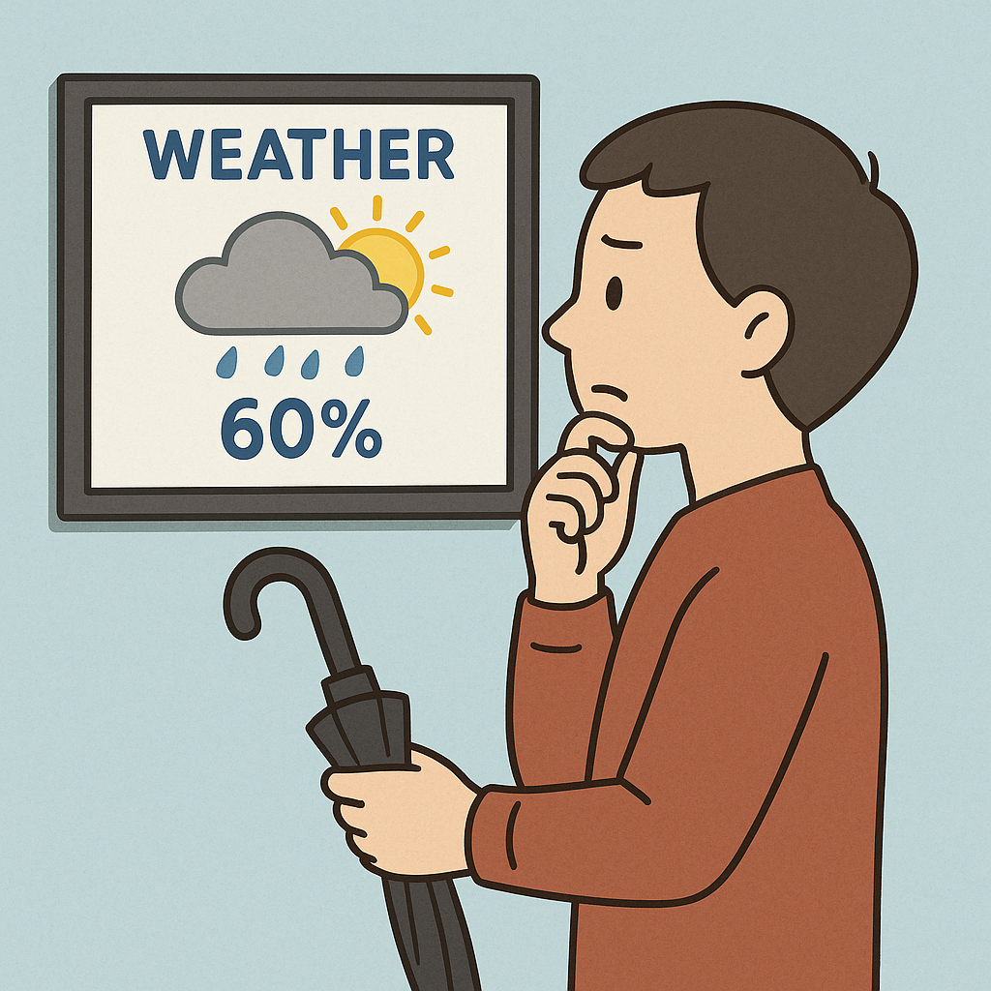
Decision Thresholds
Image by ChatGPT

Slide 25
What do Most Models Output?
Scores?
Expectations?
Probabilities?
Which of those is a decision?

Slide 26
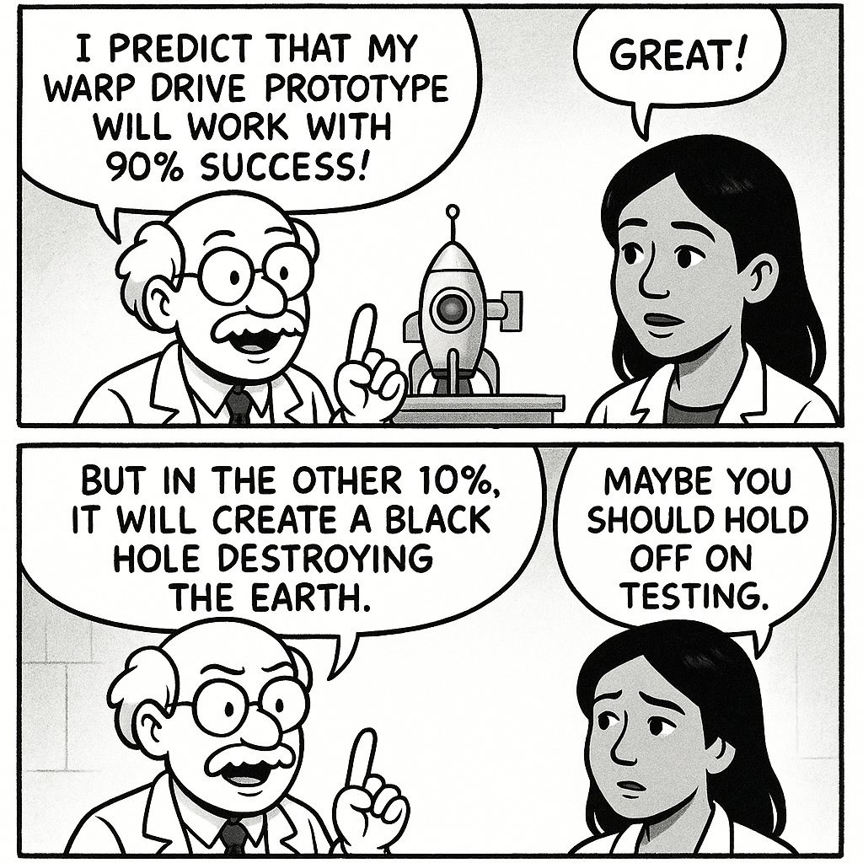
Decision Thresholds
Image by ChatGPT

Slide 27
Decisions from Thresholds
Act if score > 100
Act if expected profit > $100K
Act if probability of life on Earth being destroyed < 0.000001

Slide 28
Decision Thresholds Change Tradeoffs
Threshold for P(black hole|test)
Threshold 0.50 => do the test!
P(warp drive) = 0.90
P(black hole) = 0.10
Threshold 0.01 => wait!
P(warp drive) = 0.00
P(black hole) = 0.00

Slide 29
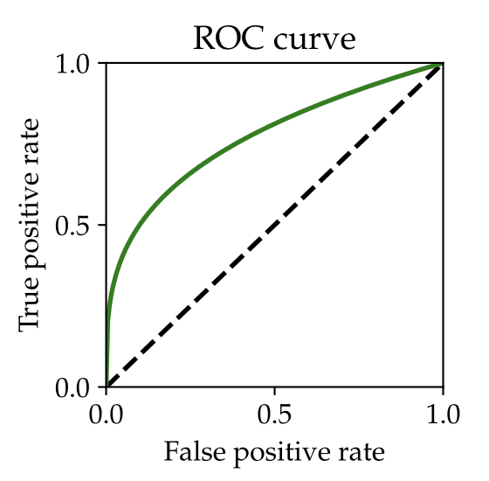
Receiver Operating Characteristic (ROC) Curves
TLDR: Plot true positive rate vs false positive rate.
What is that dashed line?
Image source: https://mlstory.org/prediction.html

Slide 30
Idealized ROC Curves
What is the best ROC curve?
What is the worst ROC curve?

Slide 31
Stupid ROC Tricks
What if your ROC curve is below the random choice line?

Slide 32
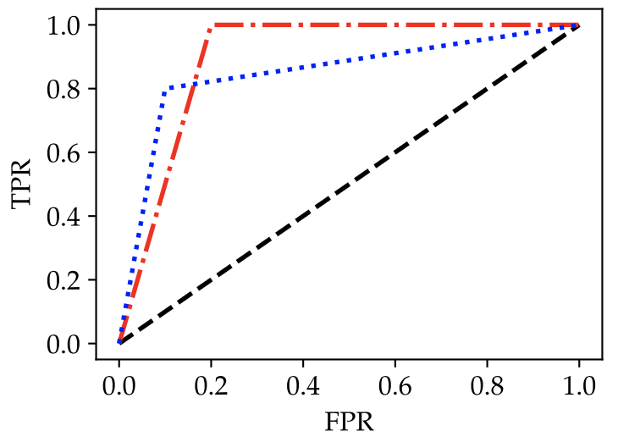
Which ROC Curve is Better?
???
Image source:
https://mlstory.org/prediction.html

Slide 33
Do ROC Curves Tell Us How to Pick Decision Thresholds?
???

Slide 34
Any Questions?

Slide 35
Utility Functions
An abstract measure of how good a result is…
Standard way to make decisions is to maximize expected utility.
If using a threshold, pick the threshold that maximizes expected utility.

Slide 36
Calculating Expected Utility
TP rate
TN rate
FP rate
FN rate
What is overall expected utility?
What information is missing?
TP utility
TN utility
FP utility
FN utility

Slide 37
Regret
An alternative evaluation method, still based on utility
Regret = benchmark utility – expected utility
Usually used if we think we should perform close to benchmark.

Slide 38
Calculating Expected Regret from Utility
TP rate
TN rate
FP rate
FN rate
What is benchmark?
TP utility
TN utility
FP utility
FN utility

Slide 39
Calculating Expected Regret from Regret
FP rate
FN rate
What is overall expected regret?
FP regret
FN regret

Slide 40
Which is better? Utility or Regret?
???

Slide 41
Utility over Time
Is $1000 more valuable today or in 10 years?

Slide 42
Diminishing Utility
Which scenario increases utility the most?
Bank balance $1,000 -> $2,000
Bank balance $10,000 -> $11,000
Bank balance $1,000,000 -> $1,010,000

Slide 43
St. Petersburg Paradox
Flip a coin: win $2 if heads, lose $2 otherwise.
You can repeat if you lose, but the stake doubles.
Stop after win.
What is the expected value in dollars?

Slide 44
A Conspicuous Omission
Responsible AI
How do we integrate ethical considerations into utility maximization?
Will discuss next lecture…

Slide 45
Any Questions?

Slide 46
What if We Don’t Have a Utility Function?
Or our utility values are uncertain?
Or our probabilities are iffy?

Slide 47
Proper Scoring Rules
If we are predicting probabilities, we should pick loss functions that drive us towards the ground truth.
Loss should be minimized by picking probability best matching “beliefs”.
Proper scoring rule pushes model to predict good probabilities.
Punting on decision threshold until later.

Slide 48
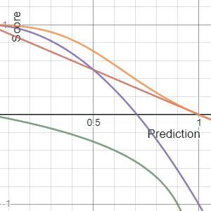
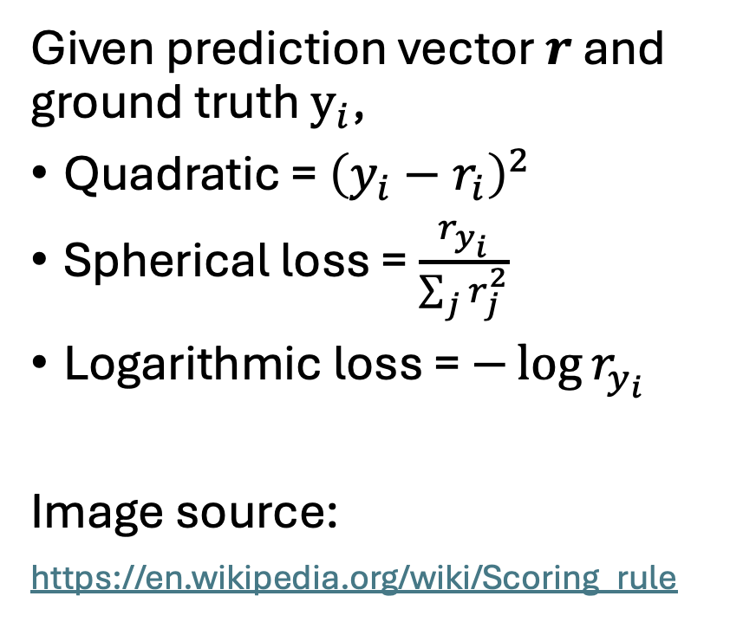
Examples of Proper Scoring Rules
Given prediction vector $r$ and ground truth $y_{i}$,
Quadratic = ${\left(y_{i}−r_{i}\right)}^{2}$
Spherical loss = $\frac{r_{y_{i}}}{\sum_{j}{r_{j}^{2}}}$
Logarithmic loss = $−\log{r_{y_{i}}}$
Image source:
https://en.wikipedia.org/wiki/Scoring_rule

Slide 49
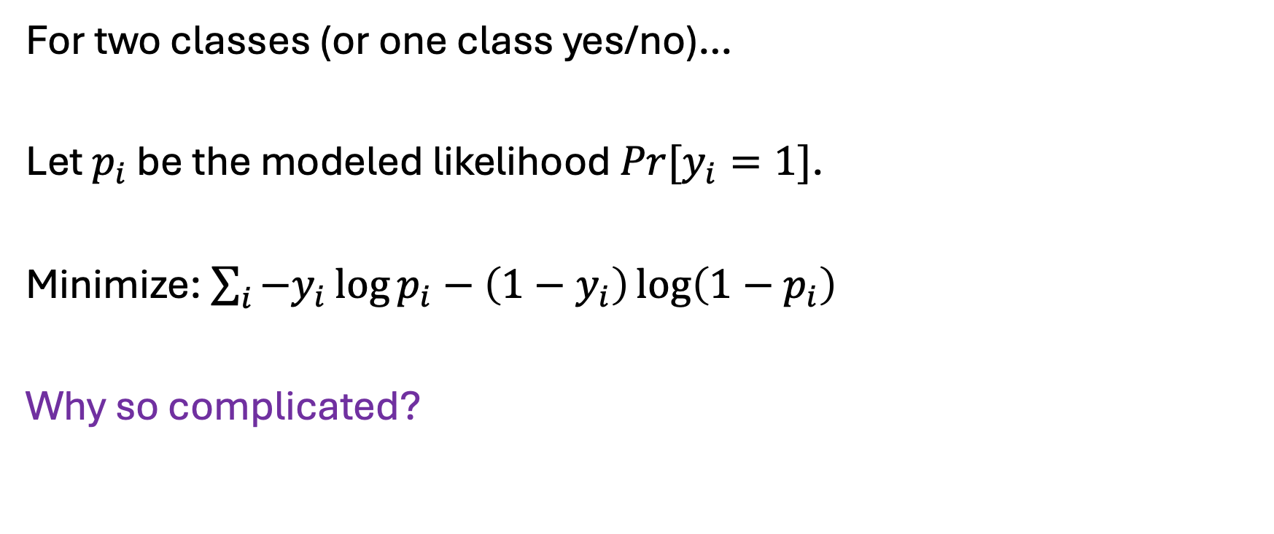
Binary Classification
For two classes (or one class yes/no)…
Let $p_{i}$ be the modeled likelihood $Pr[y_{i}=1]$.
Minimize: $\sum_{i}{{−y}_{i}\log{p_{i}}−\left(1−y_{i}\right)\log\left(1−p_{i}\right)}$
Why so complicated?

Slide 50
What if Probability is Zero?
???

Slide 51
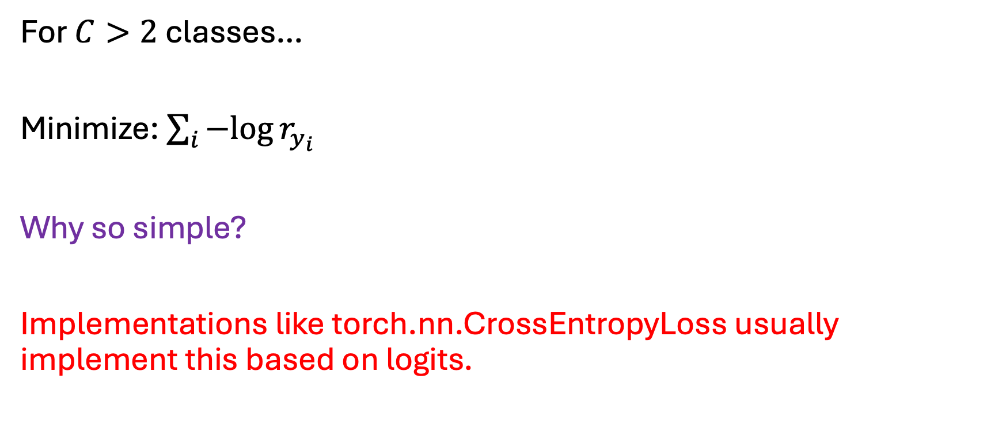
Multi-Class Classification
For $C>2$ classes…
Minimize: $\sum_{i}{−log{r_{y_{i}}}}$
Why so simple?
Implementations like torch.nn.CrossEntropyLoss usually implement this based on logits.

Slide 52
Why Two Formulas?
???

Slide 53
Any Questions?

Slide 54
AI Research at BU
College of Arts and Sciences
Computer Science
Linguistics
Math
College of Engineering
Faculty of Computing & Data Science
School of Education
School of Medicine
Etc…

Slide 55
Computer Science Faculty doing AI Research
Deepti Ghadiyaram
Boqing Gong
Najoung Kim
Vijaya Kolachalama
Bryan Plummer
(alphabetical by last name, cherry-picked for example work)
Disclaimer

Slide 56
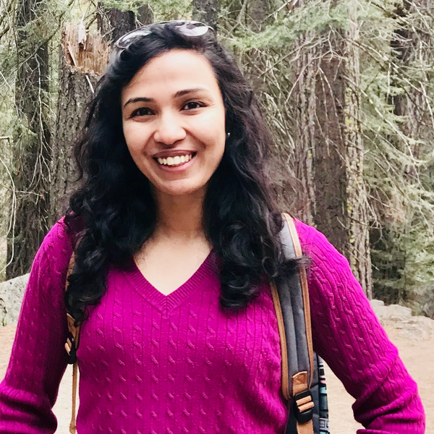
Deepti Ghadiyaram
“My research interests are in building safe, interpretable, and robust computer vision systems and also on improving their reasoning capabilities.”
Also works at Runway AI.
https://deeptigp.github.io

Slide 57
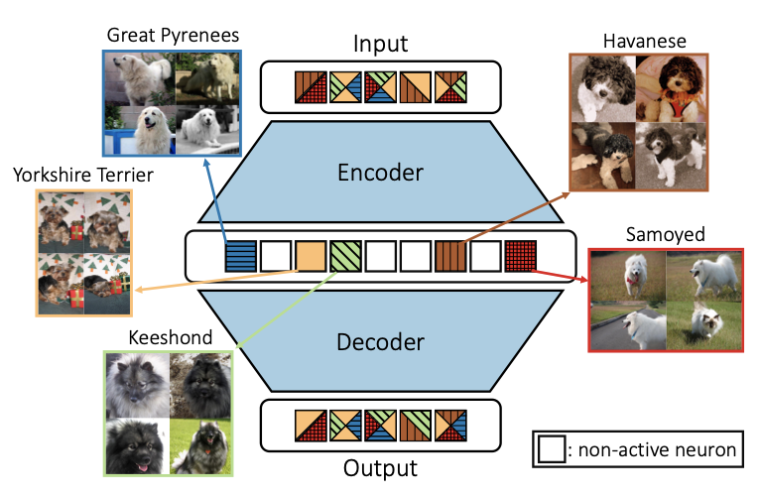
Revelio: Interpreting and leveraging semantic information in diffusion models (2025)
We study how rich visual semantic information is represented within various layers and denoising timesteps of different diffusion architectures. We uncover monosemantic interpretable features by leveraging k-sparse autoencoders (k-SAE). We substantiate our mechanistic interpretations via transfer learning using light-weight classifiers on off- the-shelf diffusion models’ features. On 4 datasets, we demonstrate the effectiveness of diffusion features for representation learning. We provide an in-depth analysis of how different diffusion architectures, pre-training datasets, and language model conditioning impacts visual representation granularity, inductive biases, and transfer learning capabilities. Our work is a critical step towards deepening interpretability of black-box diffusion models.

Slide 58
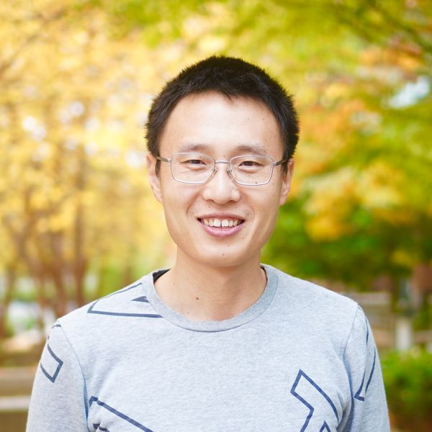
Boqing Gong
“His research on machine learning and computer vision focuses on visual recognition, video, and AI models' safety, generalization, and efficiency.”
Also works part-time at Google.
http://boqinggong.info

Slide 59
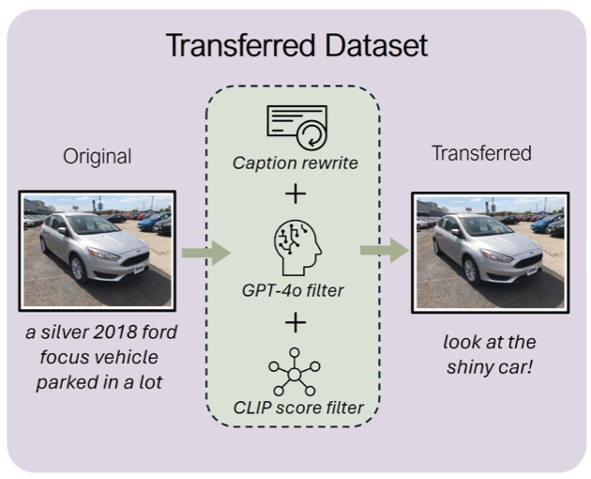
BabyVLM: Data-Efficient Pretraining of VLMs Inspired by Infant Learning
Human infants rapidly develop visual reasoning skills from minimal input, suggesting that developmentally inspired pretraining could significantly enhance the efficiency of vision-language models (VLMs). Although recent efforts have leveraged infant-inspired datasets like SAYCam, existing evaluation benchmarks remain misaligned—they are either too simplistic, narrowly scoped, or tailored for large- scale pretrained models. Additionally, training exclusively on infant data overlooks the broader, diverse input from which infants naturally learn. To address these limitations, we propose BabyVLM, a novel framework comprising comprehensive in-domain evaluation benchmarks and a synthetic training dataset created via child-directed transformations of existing datasets…

Slide 60
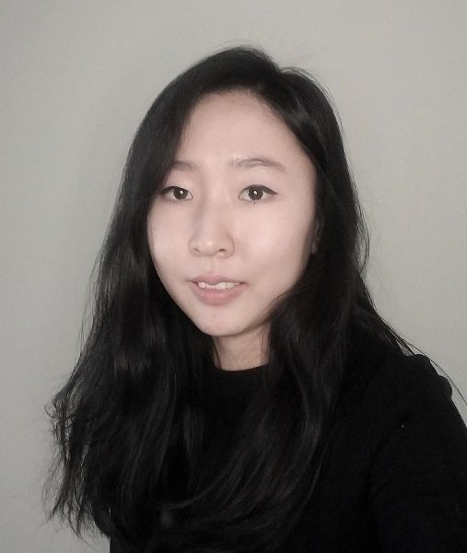
Najoung Kim (also linguistics)
“My interests, broadly, are meaning and generalization in human and machine learners. I use computational and experimental linguistic methodologies to explore these areas.”
https://najoung.kim

Slide 61

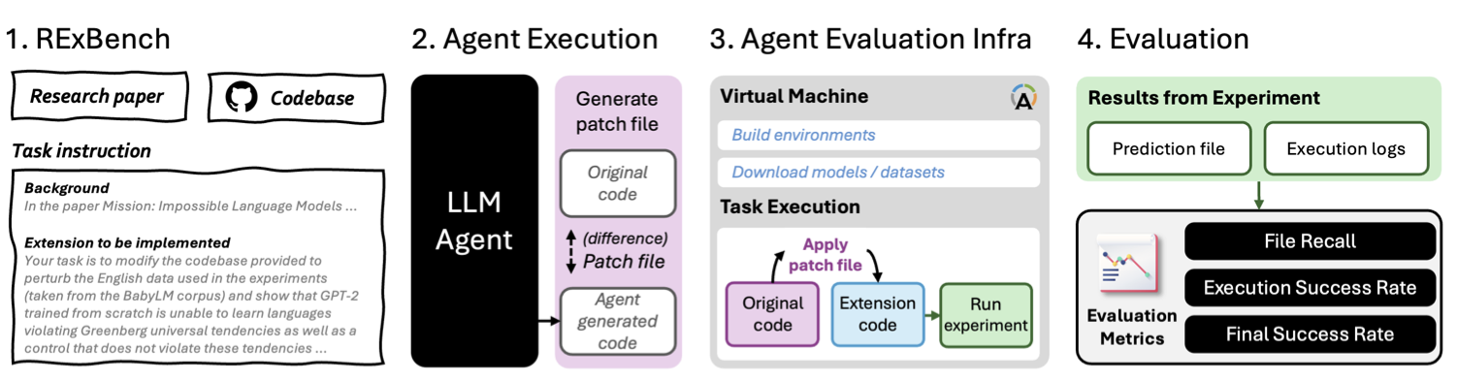
RExBench: Can coding agents autonomously implement AI research extensions?
Agents based on Large Language Models (LLMs) have shown promise for per- forming sophisticated software engineering tasks autonomously. In addition, there has been progress towards developing agents that can perform parts of the research pipeline in machine learning and the natural sciences. We argue that research extension and its implementation is a critical capability for such systems, and introduce REXBENCH to support the evaluation of this capability.

Slide 62
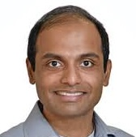
Vijaya Kolachalama (also MED+CDS)
“We are a highly interdisciplinary research group, bringing together trainees and scientists from computer science, neuroscience, bioinformatics, physics, computing and data sciences, electrical and computer engineering, and medicine. We actively collaborate with clinicians and domain experts across diverse specialties and institutions globally.”
https://www.bumc.bu.edu/camed/profile/vijaya-kolachalama/

Slide 63
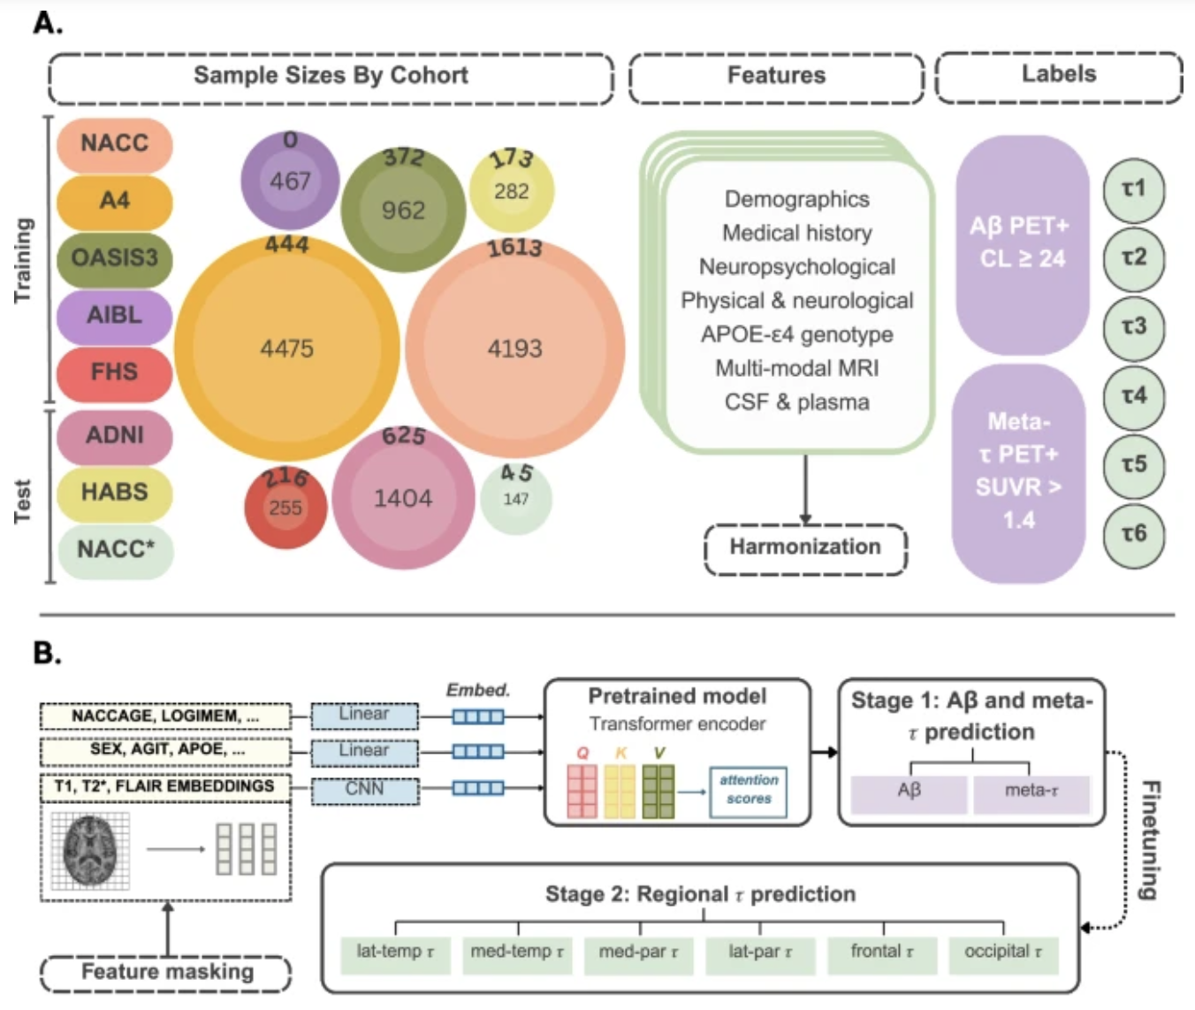
AI-driven fusion of multimodal data for Alzheimer’s disease biomarker assessment
Alzheimer’s disease (AD) diagnosis hinges on detecting amyloid beta (Aβ) plaques and neurofibrillary tau (τ) tangles. While amyloid PET imaging is now clinically approved, tau PET remains largely restricted to research settings. These imaging techniques, though valuable, are expensive and often difficult to access, limiting their widespread use in routine clinical practice. Here, we introduce a computational framework that leverages multimodal data from seven distinct cohorts comprising 12, 185 participants to estimate indi-vidual PET profiles, both global and regional, using more accessible data modalities, such as demographics, medical history, medication use, fluid measurements, functional and neuropsychological assessments, and structural MRIs.

Slide 64

Bryan Plummer
“My research interests fall within the umbrella of artificial intelligence with a focus on multimodal machine learning, efficient neural networks, explainable and fair AI, and robust ML.”
https://bryanplummer.com

Slide 65
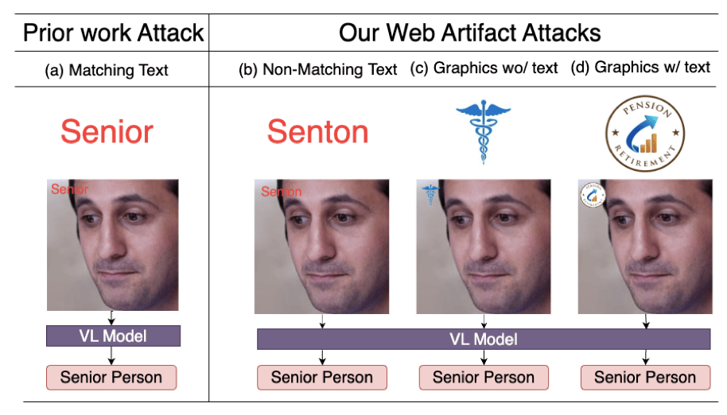
Web Artifact Attacks Disrupt Vision Language Models
Vision-language models (VLMs) (e.g., CLIP, LLaVA) are trained on large-scale, lightly curated web datasets, leading them to learn unintended correlations between semantic concepts and unrelated visual signals. These associations degrade model accuracy by causing predictions to rely on incidental patterns rather than genuine visual understanding. Prior work has weaponized these correlations as an attack vector to manipulate model predictions, such as inserting a deceiving class text onto the image in a “typographic” attack. These attacks succeed due to VLMs’ text-heavy bias—a result of captions that echo visible words rather than describing content. However, this attack has focused solely on text that matches the target class exactly, overlooking a broader range of correlations, including non-matching text and graphical symbols, which arise from the abundance of branding content in web-scale data.

